Slide 1

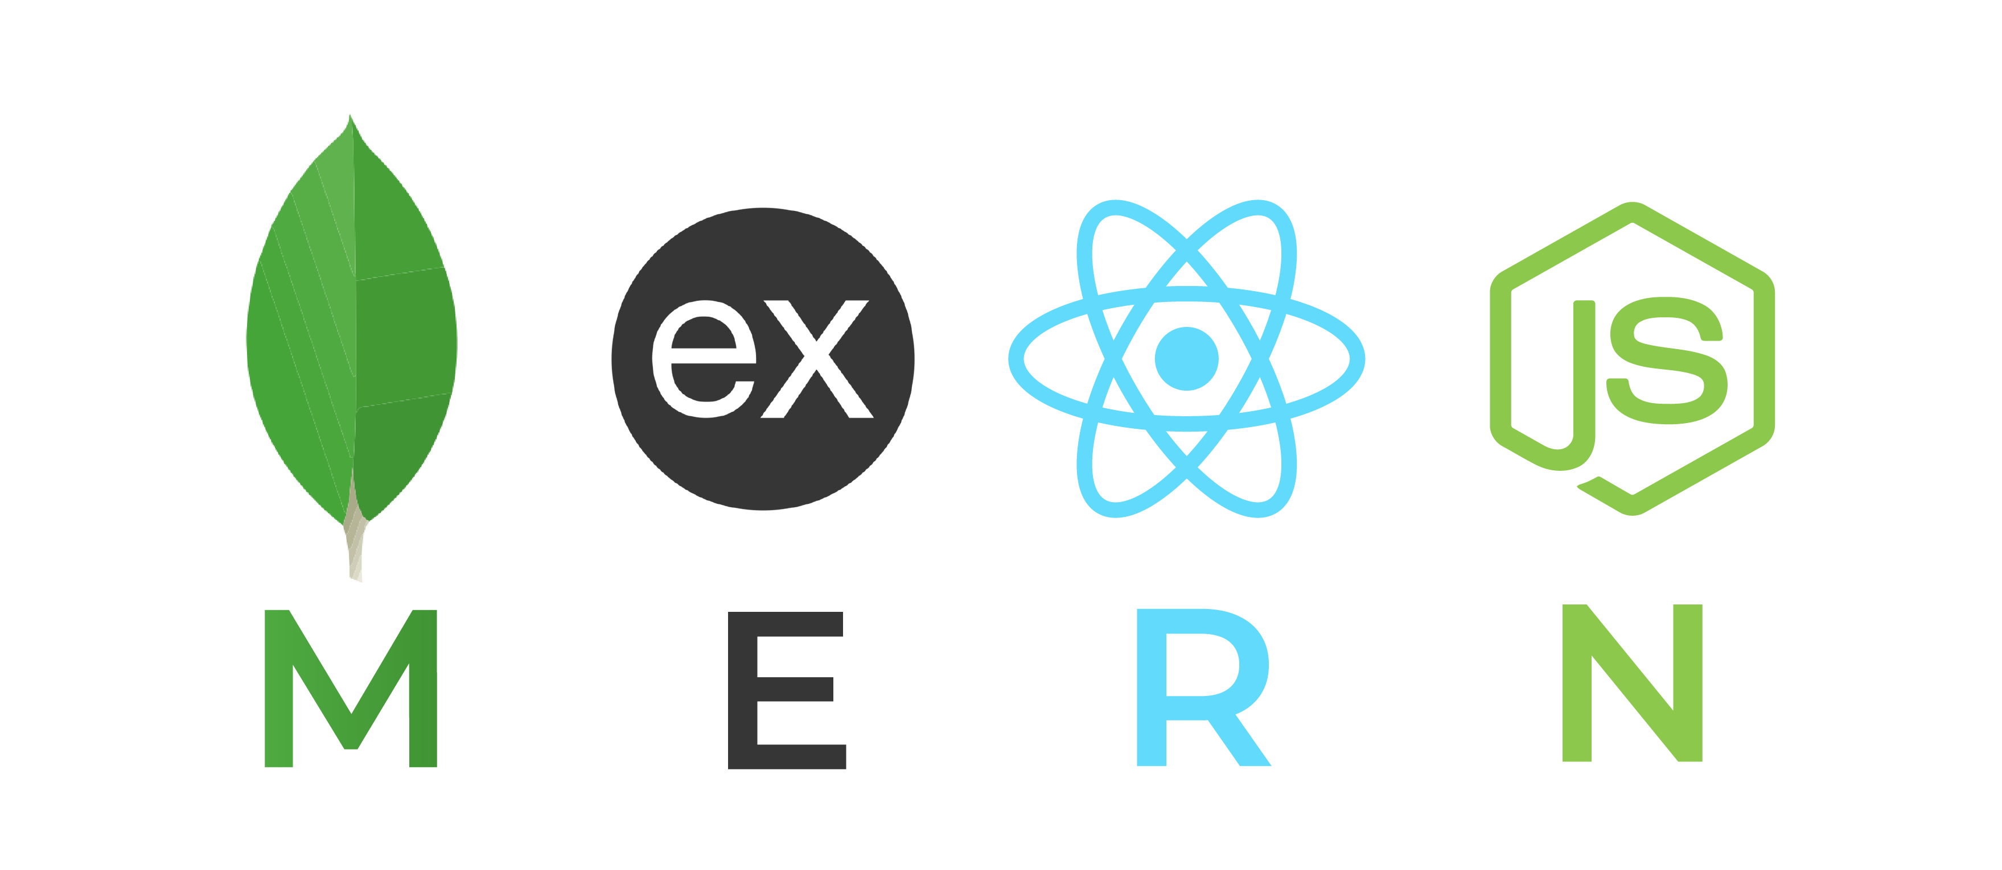
FREEDOM FRIDAY MERN Stack

Slide 2
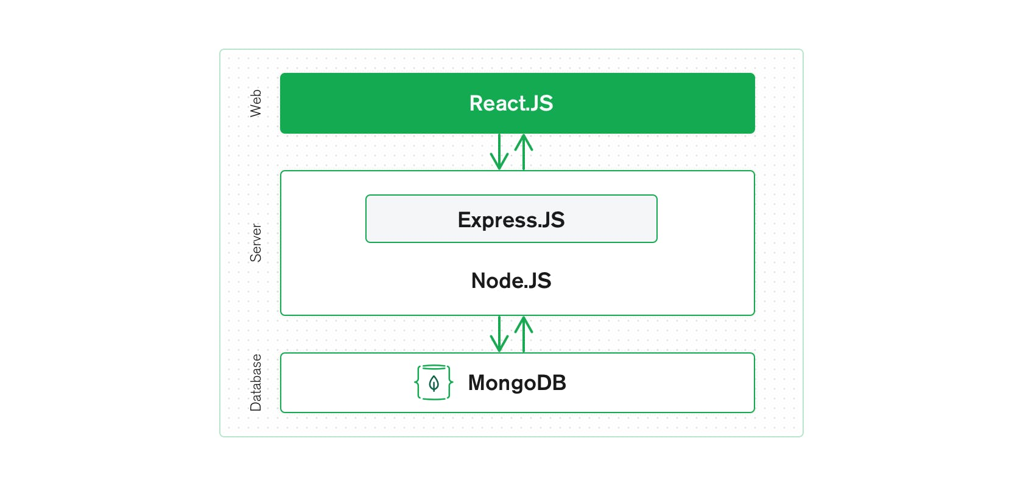
Why MERN Stack and what is MERN Stack
MongoDb,Express.js,React,Node.js
The MERN architecture allows you to easily construct a three-tier architecture (front end, back end, database) entirely using JavaScript and JSON.

Slide 3
Technology
 | MySQL | MongoDB
Written in | C++, C | C++, C and Javascript
Type | RDBMS | Document-Oriented
Main points | - Table - Row - Column | - Collection - Document - Field
Schemas | Strict | Dynamic
Scaling | Vertically | Horizontally
Key features | - Full text searching and Indexing - Triggers - SubSELECTs - Query caching - SSL support | - Auto-sharding - Native replication - Embedded data model support - Comprehensive secondary indexes - Rich query language
MongoDB
NoSQL database.
Document-oriented like JSON.
Mongoose API

Slide 4
Express.js
Flexible Node.js framework that provides robust set of features for web for web and mobile application
Routing with URL binding
Static files
Promise (async and await)
Body-parser, Cookie-parser

Slide 5
React
 | React JS | Angular JS
Author | Facebook | Google
Type | Open Source JS library | Fully-featured MVC framework
App Architecture | Node | MVC
Data Binding | Uni-Directional | Bi-Directional
DOM | Virtual DOM | Regular DOM
Front-end library developed by Facebook. It handles the view layer for web and mobile apps.
React is all about components.
React-router to handle the front-end routing.

Slide 6
Redux
Actions are payloads of information that send data from your application to your store.
Reducers specify how the application's state changes in response to actions sent to the store.
The Store is the object that brings Actions and Reducers.

Slide 7
Node.js
Very powerful JavaScript-based platform built on Google Chrome's JavaScript V8 Engine.
Single Threaded but Highly Scalable.
Callbacks and Event Driven.
Node Package Module (NPM).

Slide 8

Hosting Services
GitHub : Store the source-code
Heroku/AWS : Deploy the application
mLab : Deploy MongoDB

Slide 9
Thank You…
Any Questions?

Slide 10
